Slide 1
Java Full Stack Backend Development
Nursultan Turdaliev
Github Doc Link
MURASLABS

Slide 2
About Myself
Curriculum
(Full Stack) Backend Development
Project Proposal
Project Demo
IDE and Tools Installation
Contents

Slide 3
About Myself
B.S. and MSc. in Computer Engineering
9 Years in Computer Science
6 Years in Professional Software Development
Experience and Expertise
Web Application Development
Android Application Development
Frontend Development
Machine Learning
Software Developer About You GmbH - Ecommerce Germany

Slide 4
Curriculum
14th September - 30th November

Slide 5
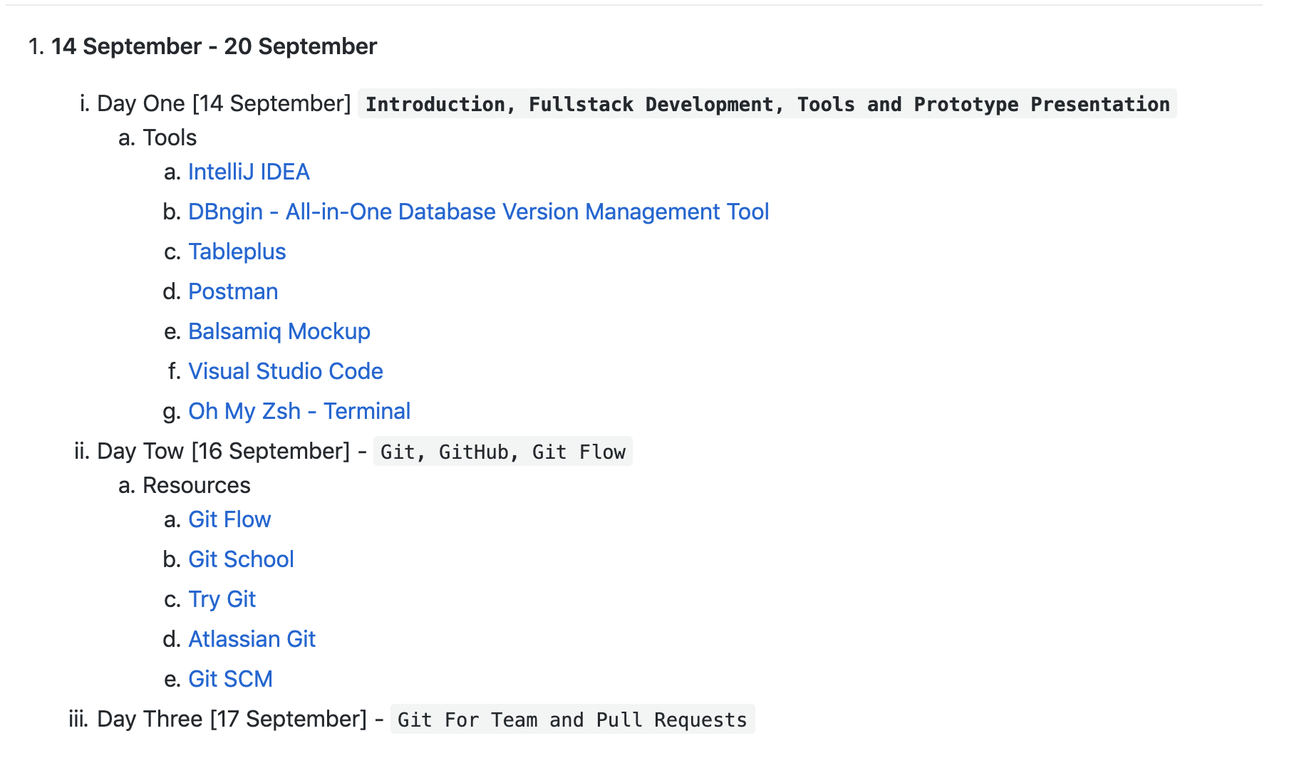
Curriculum

Slide 6
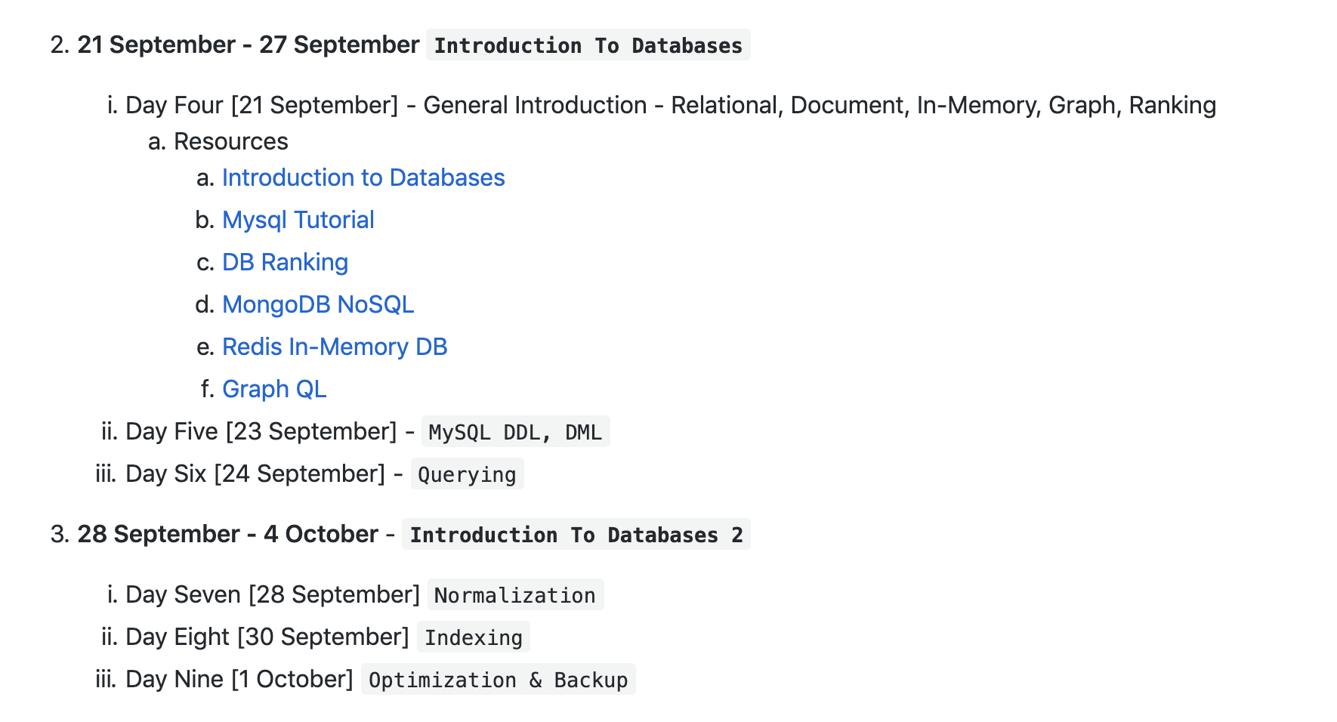
Curriculum

Slide 7
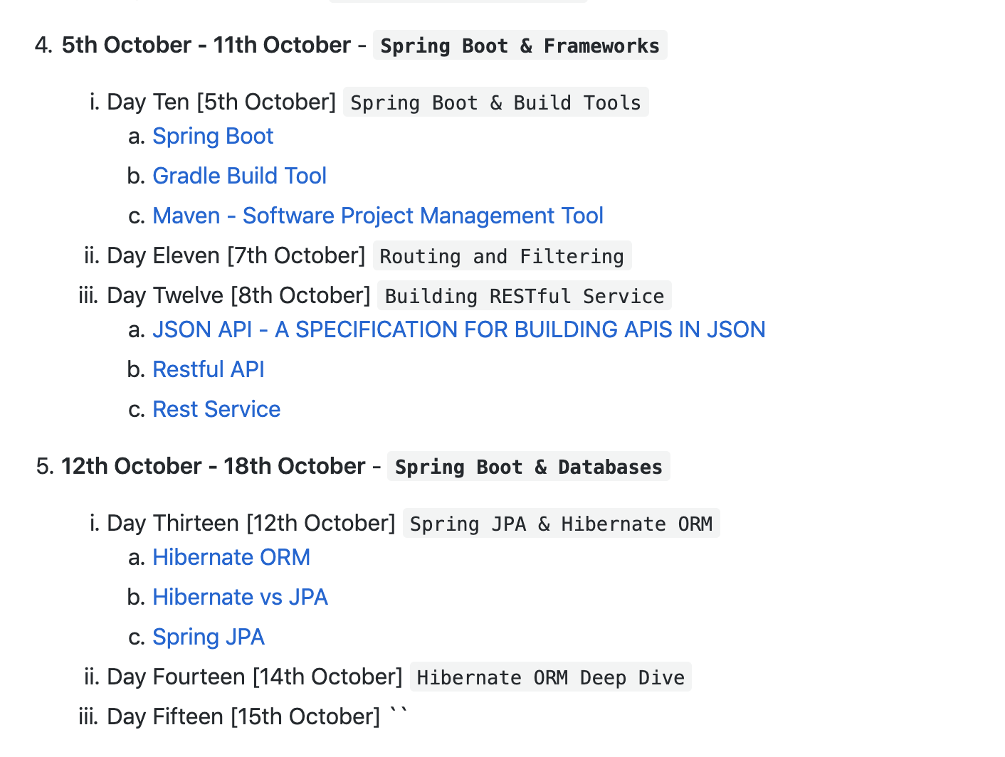
Curriculum

Slide 8
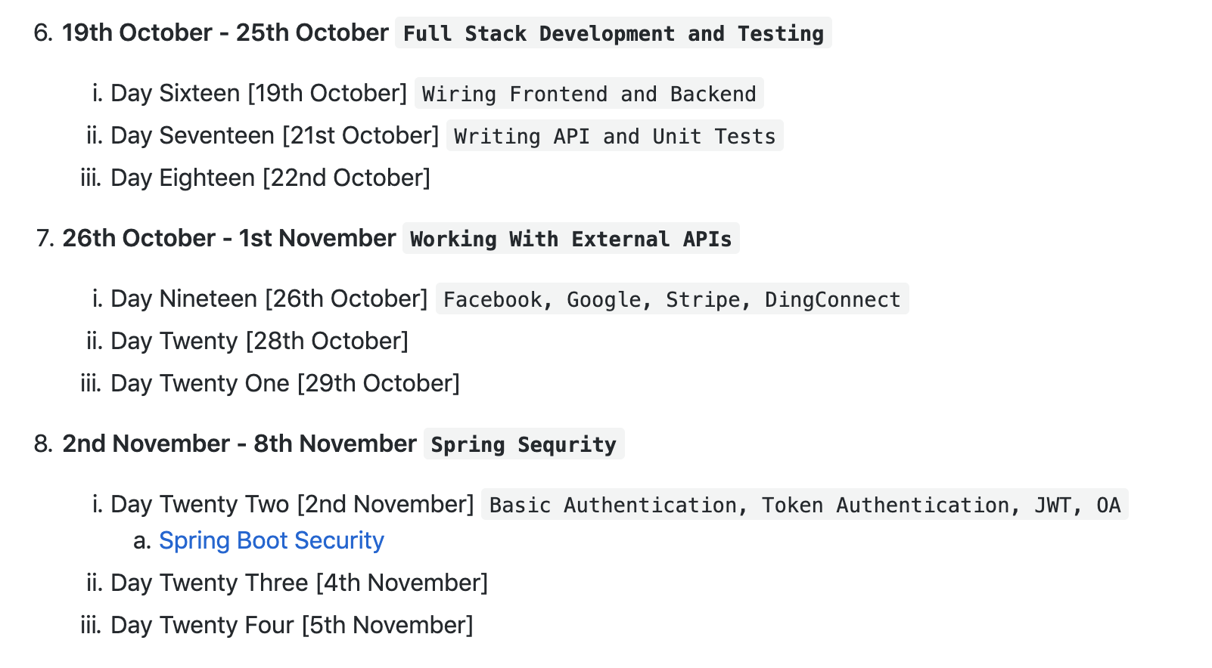
Curriculum

Slide 9
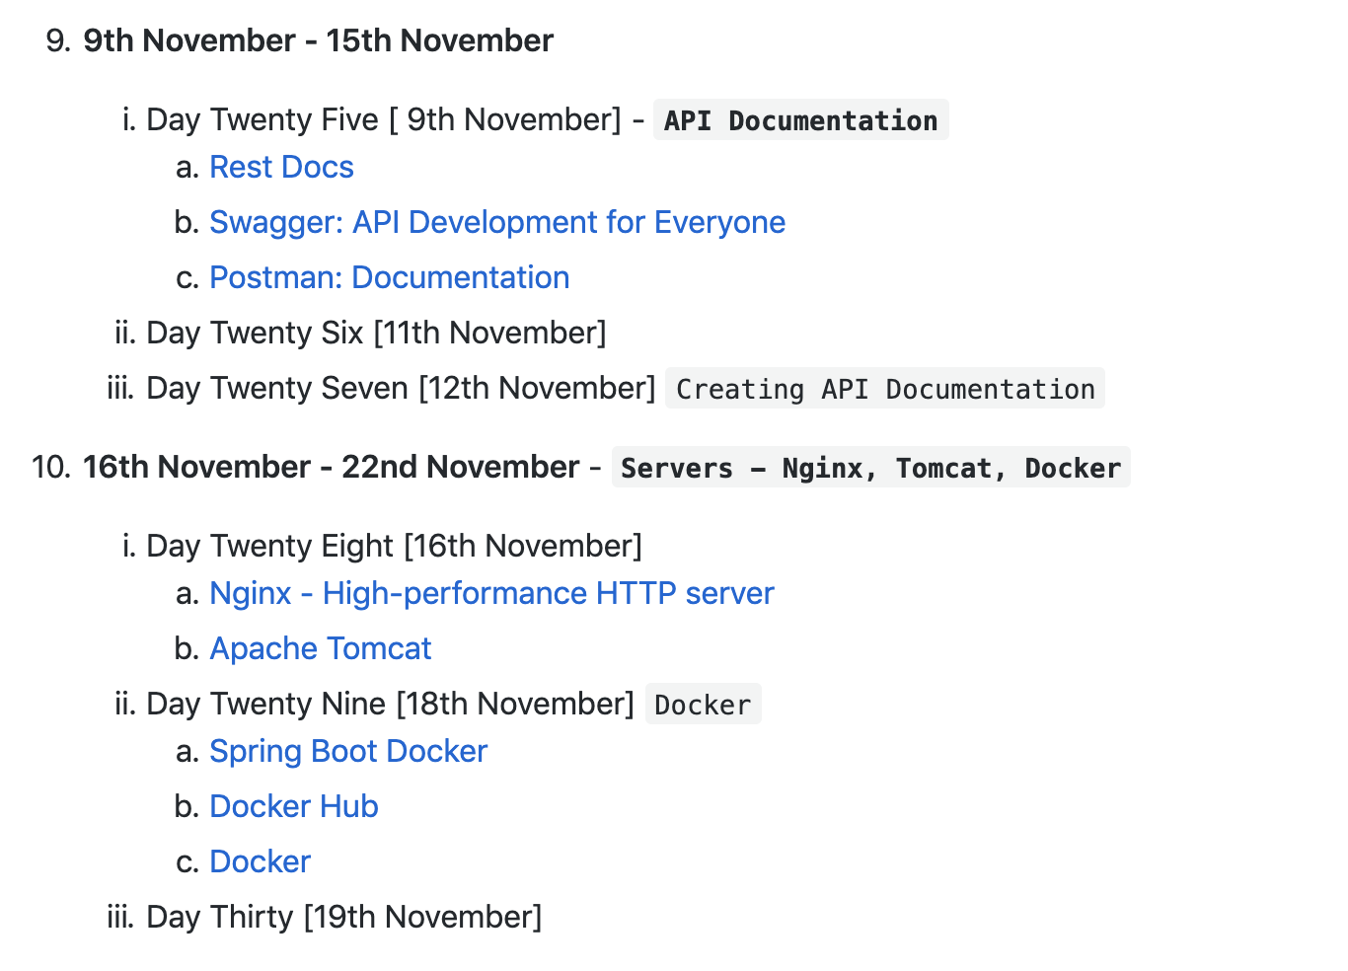
Curriculum

Slide 10
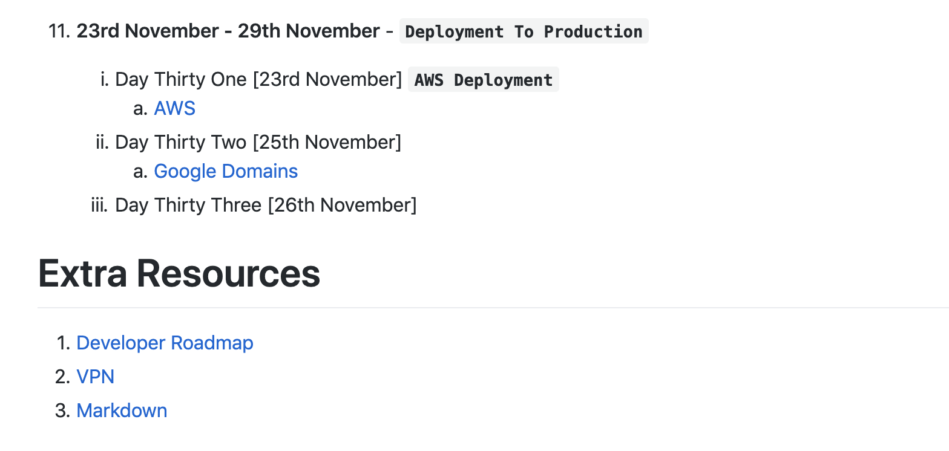
Curriculum

Slide 11
Full Stack
Backend Development

Slide 12
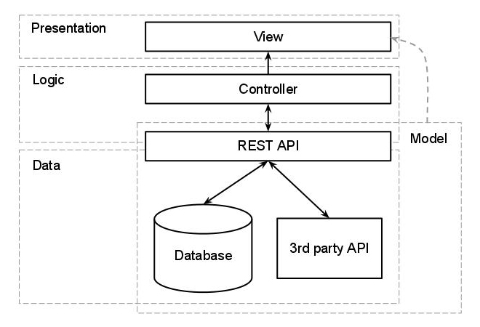
Web Application Architecture

Slide 13
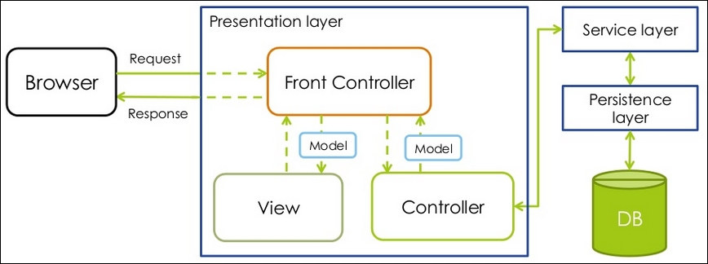
Spring MVC Architecture

Slide 14
Complete Backend Roadmap
https://github.com/muraslabs/docs#complete-backend-roadmap

Slide 15
Project Proposal
Tasks
Build Money Transfer and Top Up application from scratch.
Requirements
Kyrgyz People from abroad should be able to send top ups to Kyrgyzstan
Users should be able to see list of transactions
Super admin should be able to manage transactions, users, money transfers
Kapusta
Money Transfer

Slide 16
Balsamiq Prototype

Slide 17
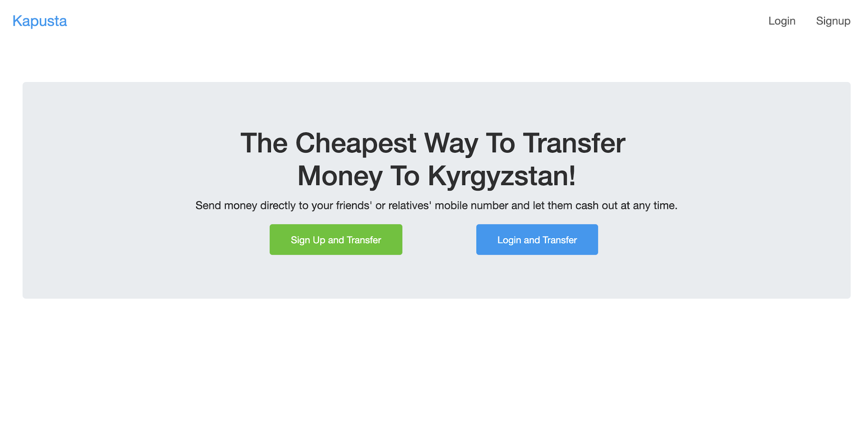
Home Page

Slide 18
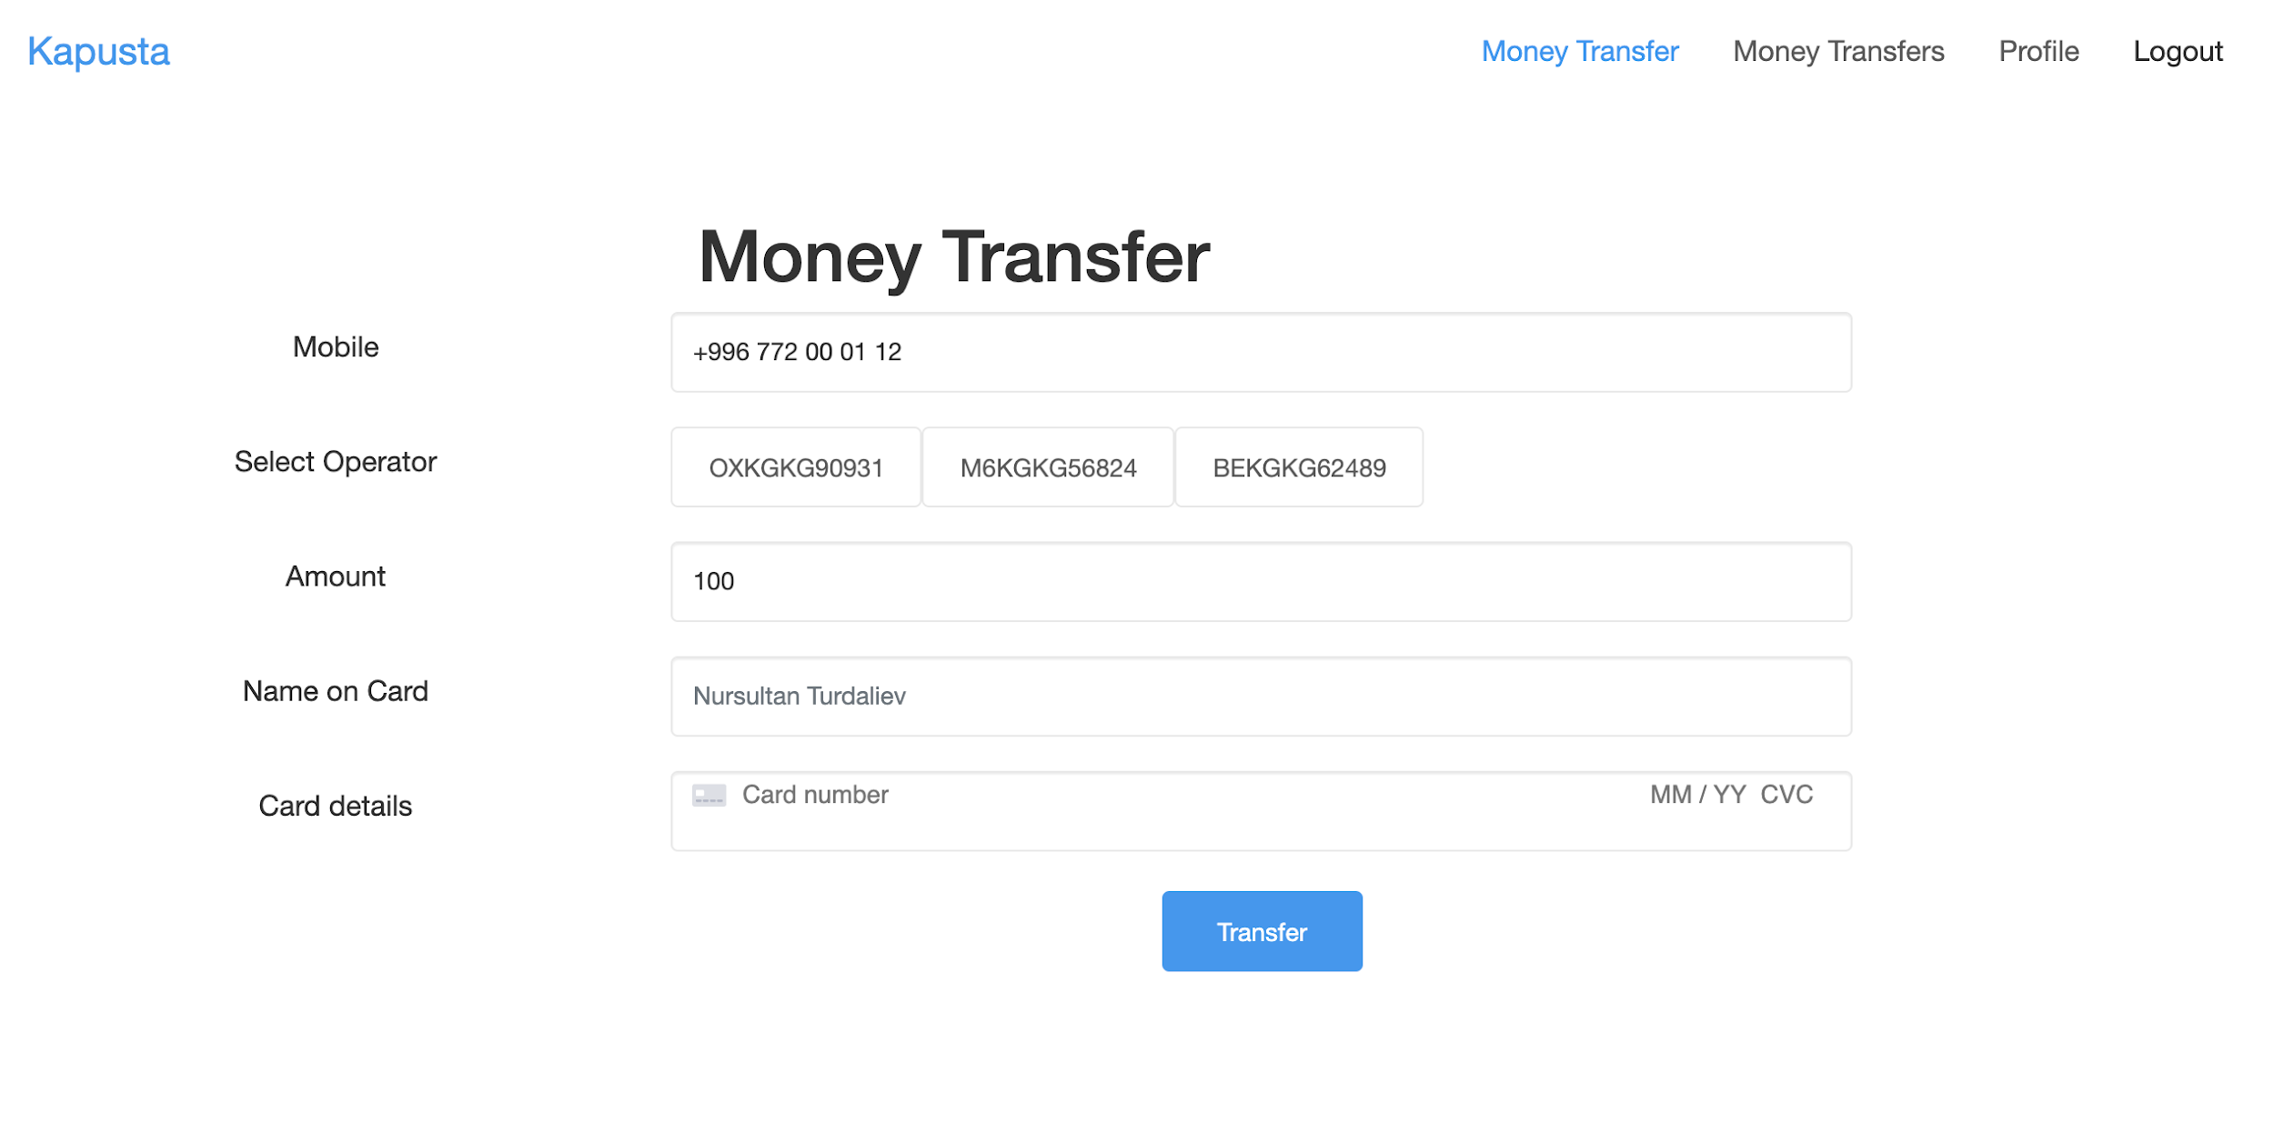
Top Up Page

Slide 19
Project Demo

Slide 20
Money Transfer
Third Party Dependencies
Stripe
Stripe is the best software platform for running an internet business. We handle billions of dollars every year for forward-thinking businesses around the world.
Facebook, Google
Registrations, Logins
DingConnect
Top Up API

Slide 21
IDE and Tools
IntelliJ IDEA
DBngin - All-in-One Database Version Management Tool
Tableplus
Postman
Balsamiq Mockup
Visual Studio Code
Oh My Zsh - Terminal

Slide 22
End Result
Feature Complete Product Deployed To Production

